Slide 1
Mehran S. Fallah March, 2020
Discrete Mathematics
Session III
The Principle of Inclusion and Exclusion

Slide 2
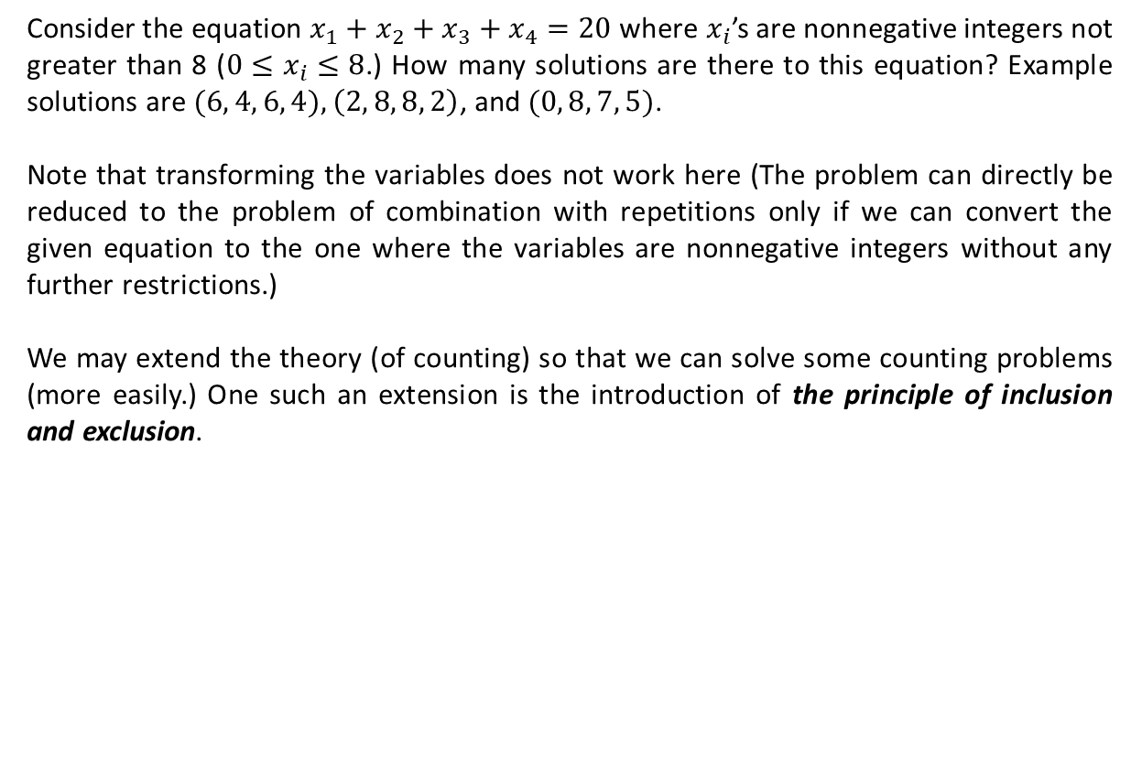
Introduction
Consider the equation $x_{1}+x_{2}+x_{3}+x_{4}=20$ where $x_{i}$’s are nonnegative integers not greater than 8 ($0≤x_{i}≤8$.) How many solutions are there to this equation? Example solutions are $(6, 4, 6, 4),$ $\left(2, 8, 8, 2\right)$, and $(0, 8, 7, 5)$.
Note that transforming the variables does not work here (The problem can directly be reduced to the problem of combination with repetitions only if we can convert the given equation to the one where the variables are nonnegative integers without any further restrictions.)
We may extend the theory (of counting) so that we can solve some counting problems (more easily.) One such an extension is the introduction of the principle of inclusion and exclusion.

Slide 3
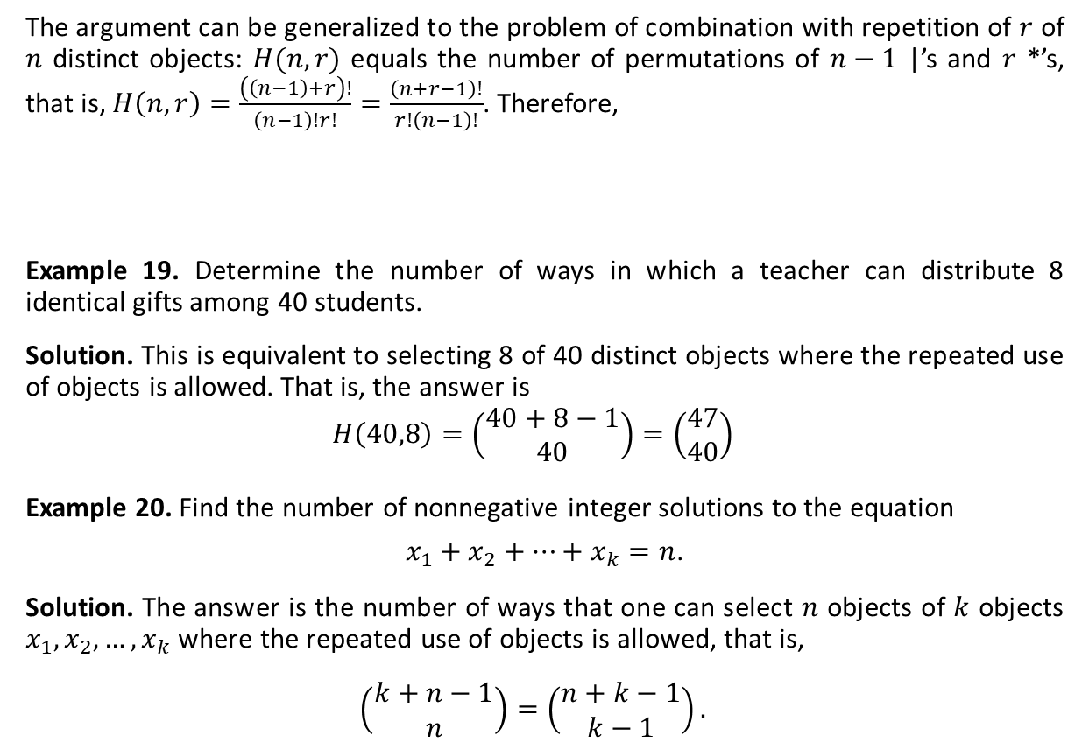
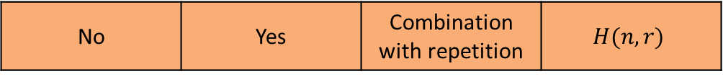
Combination with Repetition (Ctd.)
The argument can be generalized to the problem of combination with repetition of $r$ of $n$ distinct objects: $H(n,r)$ equals the number of permutations of $n−1$ |’s and $r$ *’s, that is, $H\left(n,r\right)=\frac{\left(\left(n−1\right)+r\right)!}{\left(n−1\right)!r!}=\frac{\left(n+r−1\right)!}{r!\left(n−1\right)!}$. Therefore,
Example 19. Determine the number of ways in which a teacher can distribute 8 identical gifts among 40 students.
Solution. This is equivalent to selecting 8 of 40 distinct objects where the repeated use of objects is allowed. That is, the answer is
$$H\left(40,8\right)=\left(\begin{matrix}40+8−1 \\ 40\end{matrix}\right)=\left(\begin{matrix}47 \\ 40\end{matrix}\right)$$
Example 20. Find the number of nonnegative integer solutions to the equation
$x_{1}+x_{2}+…+x_{k}=n$.
Solution. The answer is the number of ways that one can select $n$ objects of $k$ objects $x_{1}, x_{2}, …, x_{k}$where the repeated use of objects is allowed, that is,
$$\left(\begin{matrix}k+n−1 \\ n\end{matrix}\right)=\left(\begin{matrix}n+k−1 \\ k−1\end{matrix}\right).$$
$$H\left(n,r\right)=\left(\begin{matrix}n+r−1 \\ r\end{matrix}\right)=\left(\begin{matrix}n+r−1 \\ n−1\end{matrix}\right)$$

Slide 4
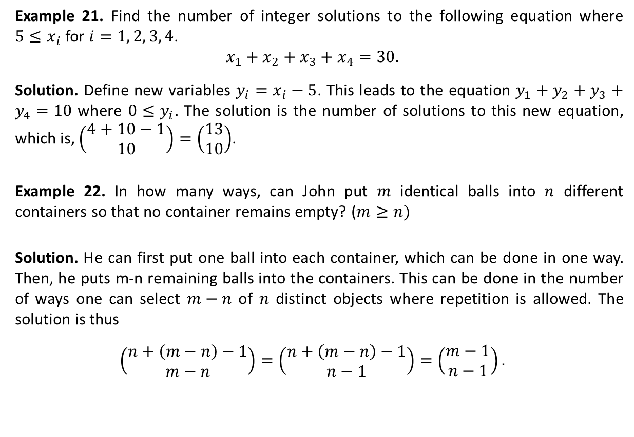
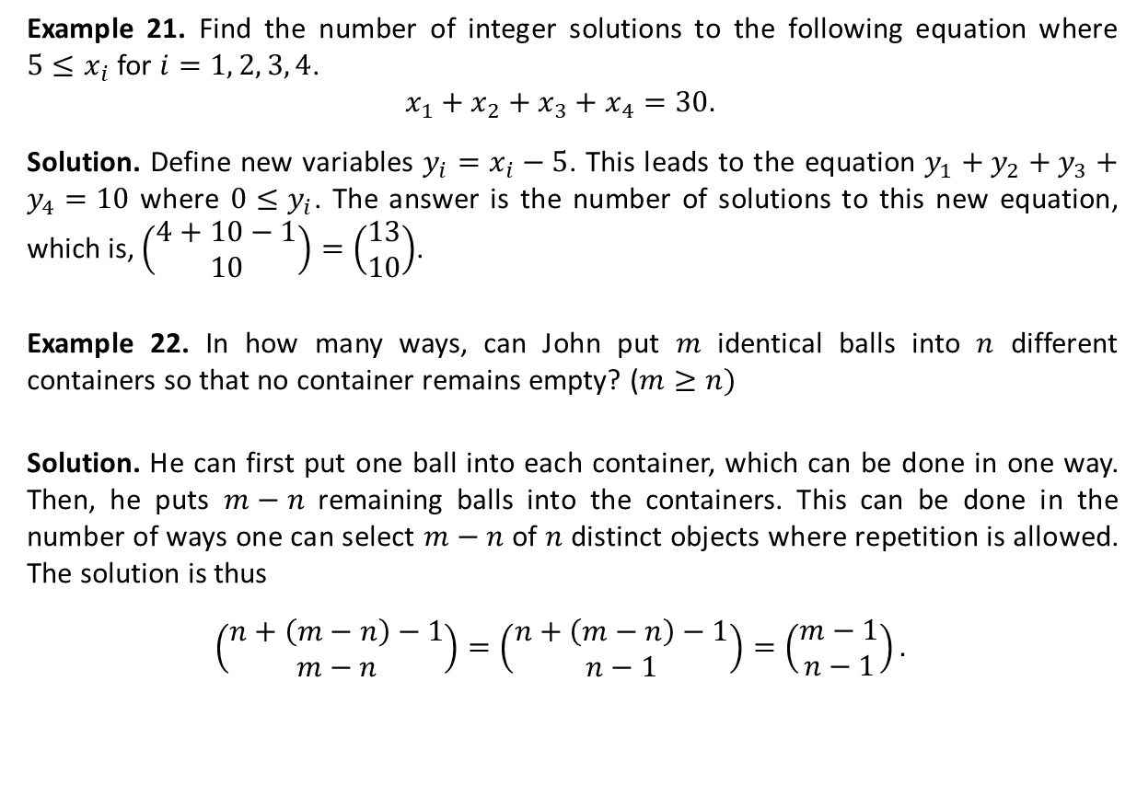
Combination with Repetition (Ctd.)
Example 21. Find the number of integer solutions to the following equation where $5≤x_{i}$ for $i=1, 2, 3, 4$.
$$x_{1}+x_{2}+x_{3}+x_{4}=30.$$
Solution. Define new variables $y_{i}=x_{i}−5$. This leads to the equation $y_{1}+y_{2}+y_{3}+y_{4}=10$ where $0≤y_{i}$. The answer is the number of solutions to this new equation, which is, $\left(\begin{matrix}4+10−1 \\ 10\end{matrix}\right)=\left(\begin{matrix}13 \\ 10\end{matrix}\right)$.
Example 22. In how many ways, can John put $m$ identical balls into $n$ different containers so that no container remains empty? ($m≥n)$
Solution. He can first put one ball into each container, which can be done in one way. Then, he puts $m−n$ remaining balls into the containers. This can be done in the number of ways one can select $m−n$ of $n$ distinct objects where repetition is allowed. The solution is thus
$$\left(\begin{matrix}n+\left(m−n\right)−1 \\ m−n\end{matrix}\right)=\left(\begin{matrix}n+\left(m−n\right)−1 \\ n−1\end{matrix}\right)=\left(\begin{matrix}m−1 \\ n−1\end{matrix}\right).$$

Slide 5
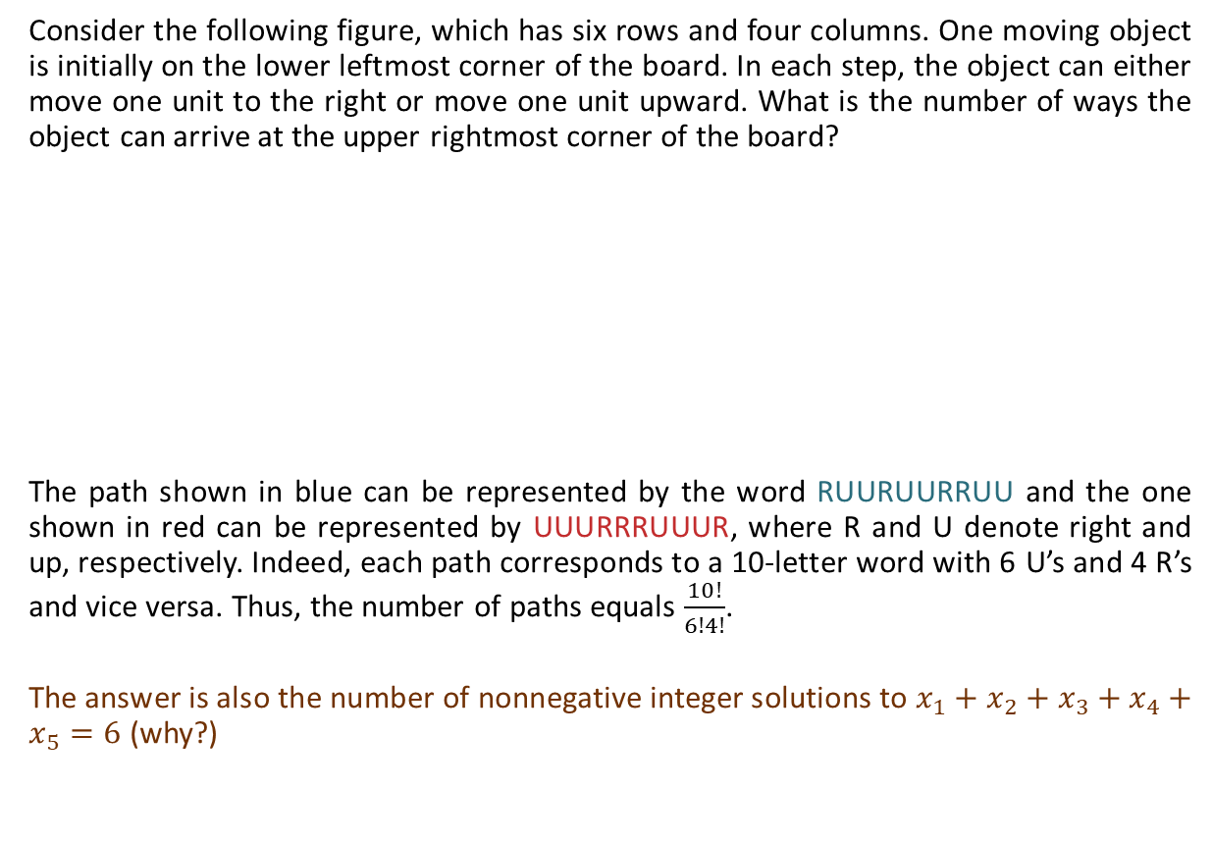
The Catalan Number
Consider the following figure, which has six rows and four columns. One moving object is initially on the lower leftmost corner of the board. In each step, the object can either move one unit to the right or move one unit upward. What is the number of ways the object can arrive at the upper rightmost corner of the board?
The path shown in blue can be represented by the word RUURUURRUU and the one shown in red can be represented by UUURRRUUUR, where R and U denote right and up, respectively. Indeed, each path corresponds to a 10-letter word with 6 U’s and 4 R’s and vice versa. Thus, the number of paths equals $\frac{10!}{6!4!}$.
The answer is also the number of nonnegative integer solutions to $x_{1}+x_{2}+x_{3}+x_{4}+x_{5}=6$ (why?)

Slide 6
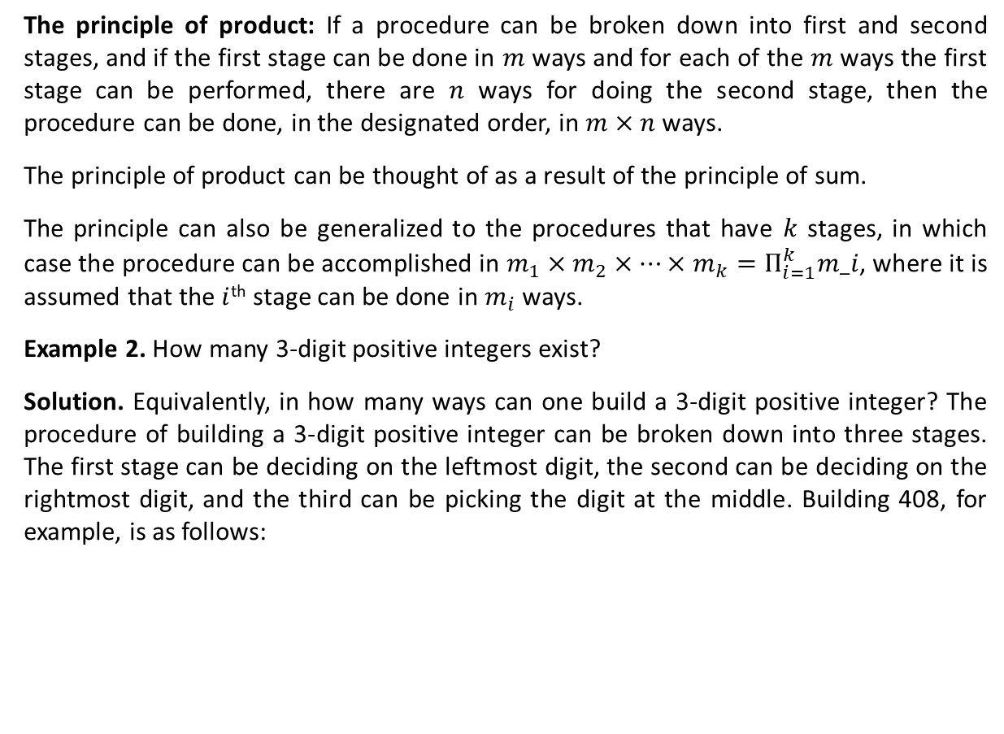
The Catalan Number (Ctd.)
Consider the following figure. Each move is one of the types U: $\left(x,y\right)⟶(x+1,y+1)$ and D: $\left(x,y\right)⟶(x+1,y−1)$. In how many ways can one travel in the $xy$-plane from (0,2) to (22,4), that is, from A to B?
As with the previous example, any path from $A$ to $B$ corresponds to a permutation of 12 U’s and 10 D’s. Therefore, the number of paths from $A$ to $B$ is $N_{AB}=\frac{22!}{12!10!}=3,628,800$.
Can you find the number of paths from $A$ to $B$ that touch or cross the $x$-axis?
Consider the brown path in the figure, it corresponds to the dashed brown path, which is the result of reflecting the segment of the brown path from $A$ to the first point it reaches (touches or crosses) the $x$-axis. The same holds for the red path. Thus, the number of paths from $A$ to $B$ that touch or cross the $x$-axis is equal to the number of paths from $A′$ to $B$ where $A′$ is the result of reflecting $A$ in the $x$-axis, that is, $N_{A^{′}B}=\frac{22!}{14!8!}=319,770$.
y
B (22,4)
A (0,2)
x
A’ (0,-2)

Slide 7
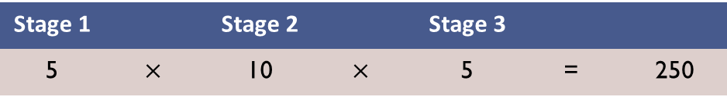
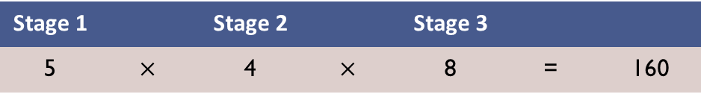
The Catalan Number (Ctd.)
y
Can you find the number of paths from $A$ to $B$ that cross the $x$-axis?
Such paths touch or cross the line $y=−1$. So, we can reflect A in line y=-1, which results in the point A’’(0,-4). The number of paths from A to B that cross the x-axis is thus the number of paths from A’’ to B, that is, $N_{A^{′′}B}=\frac{22!}{15!7!}=170,544$.
B (22,4)
A (0,2)
x
$$y=−1$$
A’’(0,-4)

Slide 8
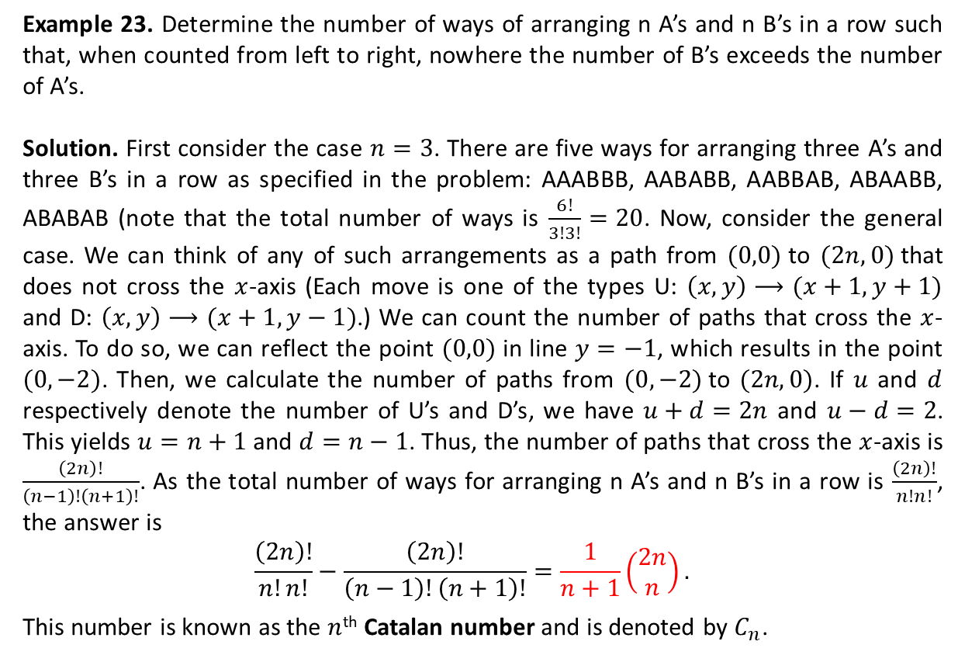
The Catalan Number (Ctd.)
Y
B
Example 23. Determine the number of ways of arranging n A’s and n B’s in a row such that, when counted from left to right, nowhere the number of B’s exceeds the number of A’s.
Solution. First consider the case $n=3$. There are five ways for arranging three A’s and three B’s in a row as specified in the problem: AAABBB, AABABB, AABBAB, ABAABB, ABABAB (note that the total number of ways is $\frac{6!}{3!3!}=20$. Now, consider the general case. We can think of any of such arrangements as a path from $(0,0)$to $(2n,0)$that does not cross the $x$-axis (Each move is one of the types U: $\left(x,y\right)⟶(x+1,y+1)$ and D: $\left(x,y\right)⟶(x+1,y−1)$.) We can count the number of paths that cross the $x$-axis. To do so, we can reflect the point $(0,0)$in line $y=−1$, which results in the point $(0,−2)$. Then, we calculate the number of paths from $(0,−2)$to $(2n,0)$. If $u$ and $d$ respectively denote the number of U’s and D’s, we have $u+d=2n$ and $u−d=2$. This yields $u=n+1$ and $d=n−1$. Thus, the number of paths that cross the $x$-axis is $\frac{\left(2n\right)!}{\left(n−1\right)!\left(n+1\right)!}$. As the total number of ways for arranging n A’s and n B’s in a row is $\frac{\left(2n\right)!}{n!n!}$, the answer is
$$\frac{\left(2n\right)!}{n!n!}−\frac{\left(2n\right)!}{\left(n−1\right)!\left(n+1\right)!}=\frac{1}{n+1}\left(\begin{matrix}2n \\ n\end{matrix}\right).$$
This number is known as the $n$^{th} Catalan number and is denoted by $C_{n}$.
A
B
A
B
B
A
B
A
X
A
B
A

Slide 9
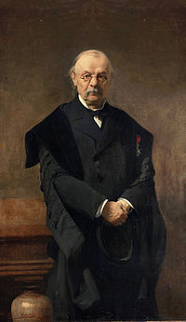













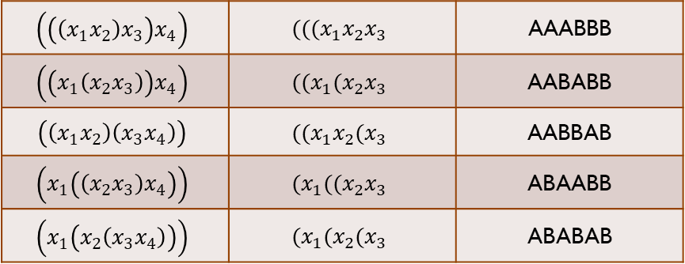












The Catalan Number (Ctd.)
$$(((x_{1}x_{2}x_{3}$$
$$(((x_{1}x_{2}x_{3}$$
$$x_{4})$$
$$(((x_{1}x_{2}$$
$$x_{3}$$
$$)$$
$$x_{4})$$
The Catalan numbers appear in many counting problems. They are $C_{0}=1$, $C_{1}=1$, $C_{2}=2$, $C_{3}=5$, $C_{4}=14$, $C_{5}=42$ , and so on.
Eugene Charles Catalan first used these numbers in determining the number of ways to parenthesize the product $x_{1}x_{2}x_{3}x_{4}⋯x_{n},$ meaning the number of ways that one can pair off the factors to do multiplication.
For instance, the five ways of parenthesizing $x_{1}x_{2}x_{3}x_{4}$ are as follows:
$\left(\left(\left(x_{1}x_{2}\right)x_{3}\right)x_{4}\right)$, $\left(\left(x_{1}\left(x_{2}x_{3}\right)\right)x_{4}\right)$, $\left(\left(x_{1}x_{2}\right)\left(x_{3}x_{4}\right)\right)$, $\left(x_{1}\left(\left(x_{2}x_{3}\right)x_{4}\right)\right)$, $\left(x_{1}\left(x_{2}\left(x_{3}x_{4}\right)\right)\right)$
Consider the following table where we find five ways to parenthesize $x_{1}x_{2}x_{3}x_{4}$ following table
$$x_{4})$$
$$(((x_{1}x_{2}$$
$$)$$
$$x_{3}$$
$$)$$
$$(x_{1}{((x}_{2}x_{3}$$
$$(x_{1}{((x}_{2}x_{3}$$
$$x_{4})$$
$$(x_{1}{((x}_{2}x_{3}$$
$$)$$
$$x_{4})$$
$$(x_{1}{((x}_{2}x_{3}$$
$$x_{4}$$
$$)$$
$$)$$
$$)$$
Thus, the answer is $C_{3}$. That is, $\frac{1}{3+1}\left(\begin{matrix}6 \\ 3\end{matrix}\right)=5$.
$$\left(\left(\left(x_{1}x_{2}\right)x_{3}\right)x_{4}\right)$$ | $$(((x_{1}x_{2}x_{3}$$ | AAABBB
$$\left(\left(x_{1}\left(x_{2}x_{3}\right)\right)x_{4}\right)$$ | $$((x_{1}(x_{2}x_{3}$$ | AABABB
$$\left(\left(x_{1}x_{2}\right)\left(x_{3}x_{4}\right)\right)$$ | $$((x_{1}x_{2}(x_{3}$$ | AABBAB
$$\left(x_{1}\left(\left(x_{2}x_{3}\right)x_{4}\right)\right)$$ | $$(x_{1}((x_{2}x_{3}$$ | ABAABB
$$\left(x_{1}\left(x_{2}\left(x_{3}x_{4}\right)\right)\right)$$ | $$(x_{1}(x_{2}(x_{3}$$ | ABABAB
Eugene Charles Catalan (1814-1894)

Slide 10
Textbook: Ralph P. Grimaldi, Discrete and Combinatorial Mathematics
Do exercises of Chapter 1 as homework and upload your solutions via Moodle (follow the instructions on the page of the TA course.)

